Slide 1


Slide 2


Slide 3
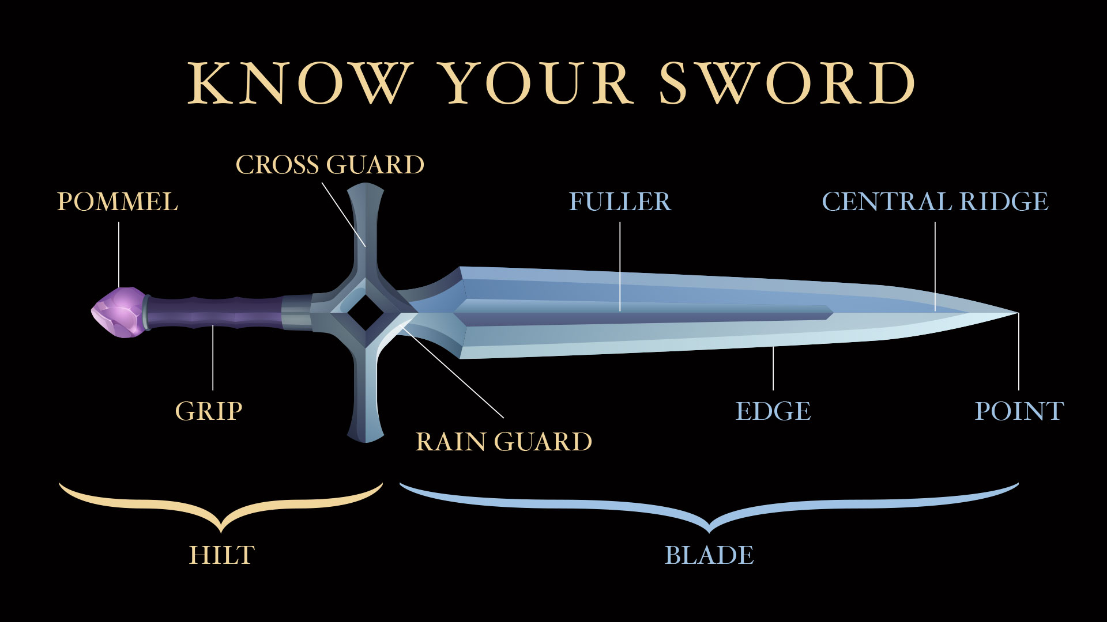

Slide 4


Slide 5


Slide 7
The additional slides below are
provided so the PowerPoint can be adapted to best fit your needs.

Slide 8


Slide 9


